Slide 1

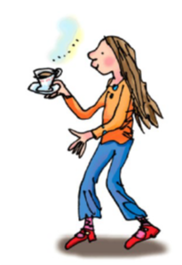
ea
Cup of tea.

Slide 2

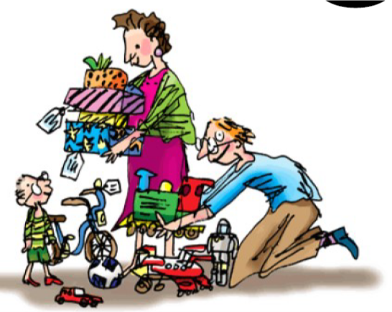
oi
Spoil the boy.

Slide 3

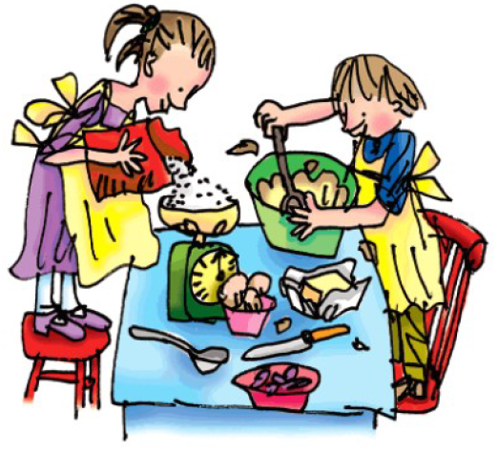
a-e
Make a cake.

Slide 4

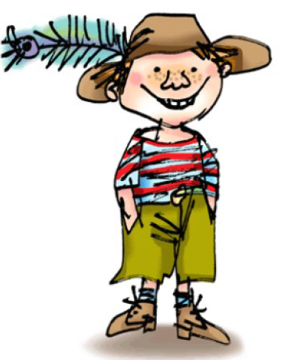
i-e
Nice smile.

Slide 5

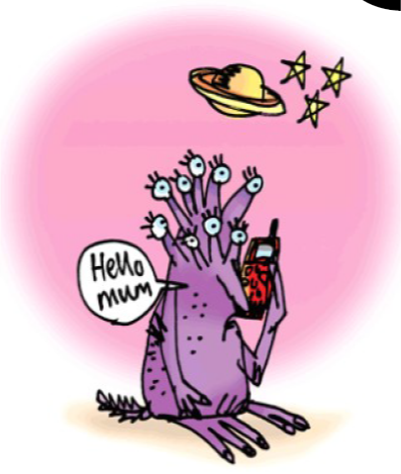
o-e
phone home.

Slide 6
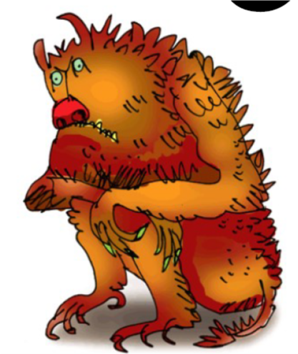
u-e
huge brute.

Slide 7

aw
Yawn at dawn.

Slide 8
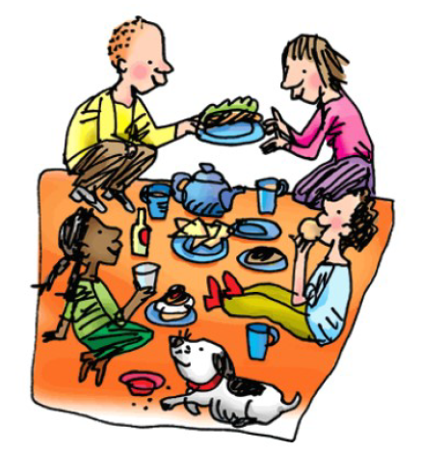
are
Share and care.

Slide 9
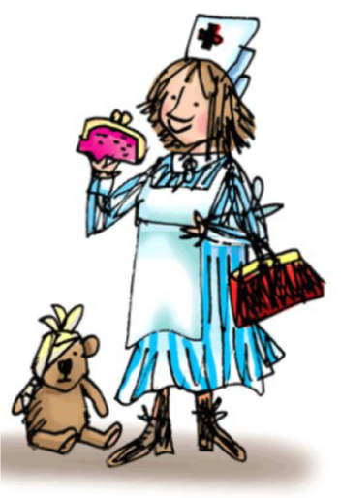
ur
Nurse with a purse.

Slide 10
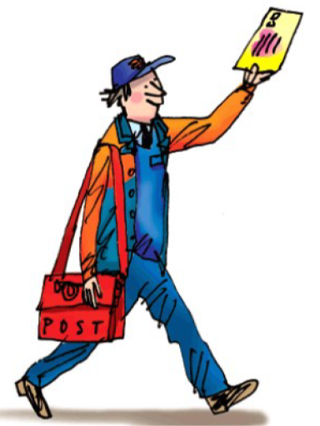
er
A better letter.

Slide 11
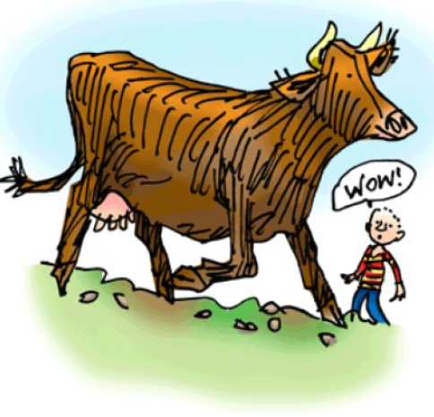
ow
brown cow!

Slide 12
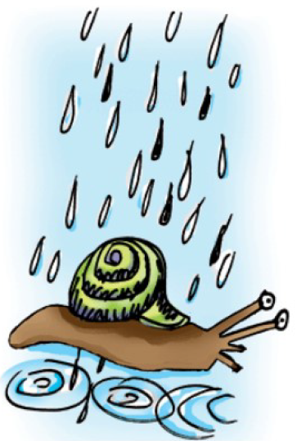
ai
Snail in the rain.

Slide 13
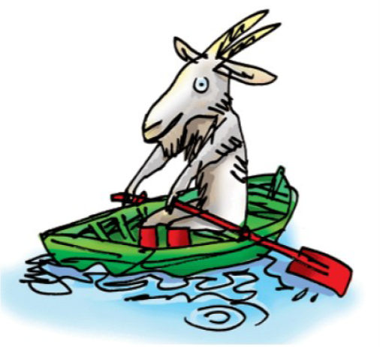
oa
Goat in a boat.

Slide 14
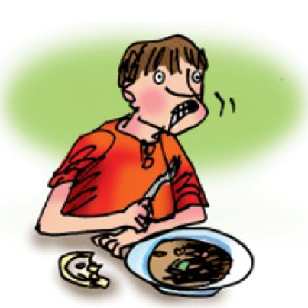
ew
Chew the stew.

Slide 15
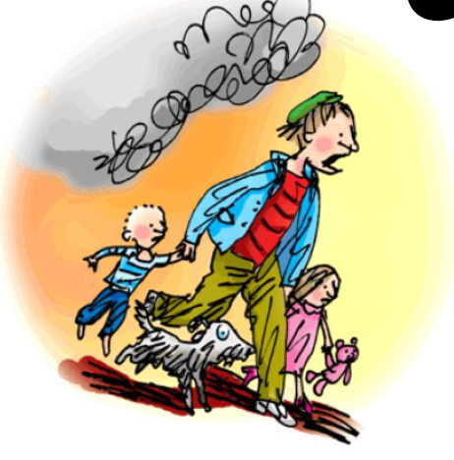
ire
Fire Fire!

Slide 16
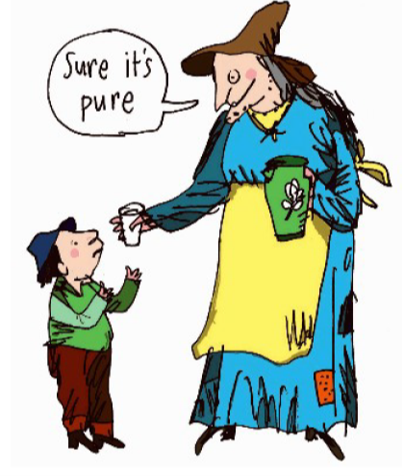
ure
Sure it’s pure.

Slide 17
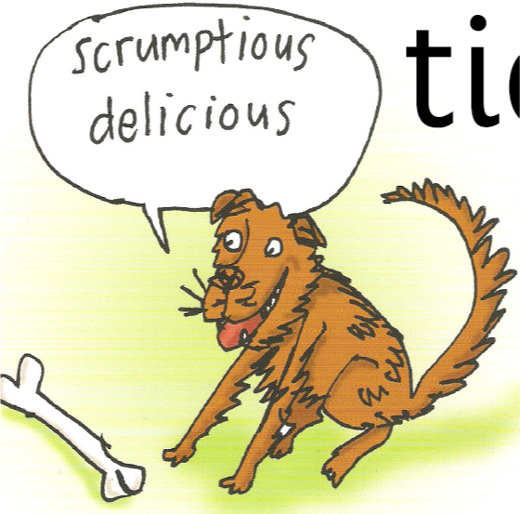
tious
cious
|
Scrumptious, delicious.

Slide 18

tion
sion
Pay attention, it’s a celebration and it’s on television.

Slide 19
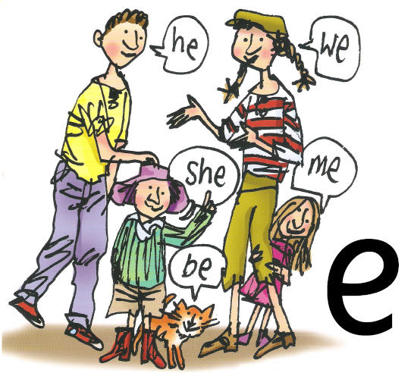
e
he, we, she, me, be

Slide 20
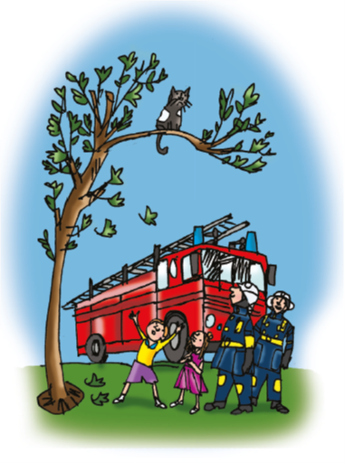
ue
Come to the rescue.

Slide 21
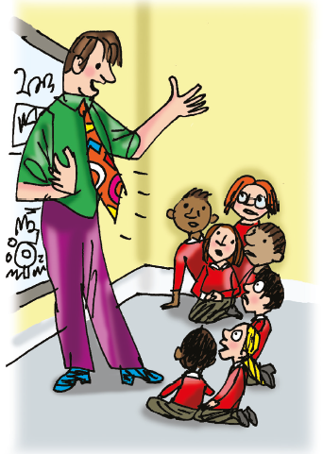
ie
Terrible tie.

Slide 22
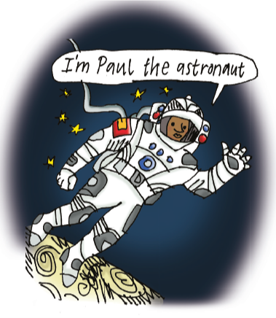
au
Paul the astronaut.

Slide 23
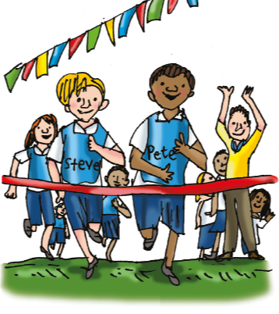
e-e
Go Pete and Steve.

Slide 24
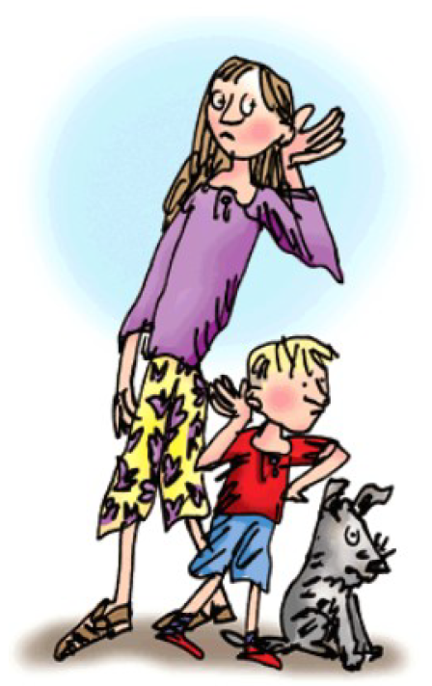
ear
Hear with your ear.

Slide 25
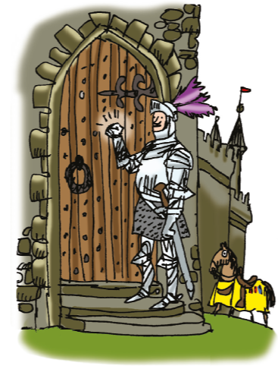
kn
Knock knock who’s there?

Slide 26
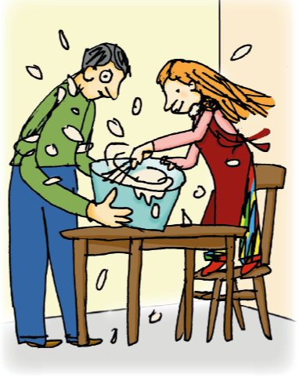
wh
Whisk, Whisk.

Slide 27
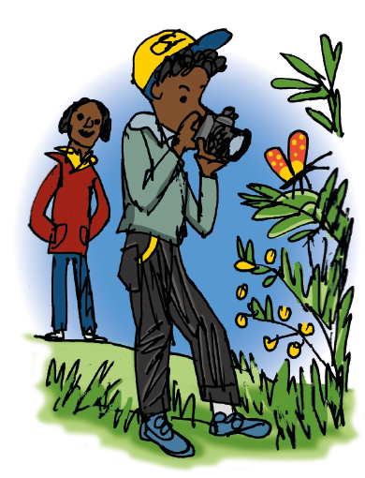
ph
Take a photo.

Slide 28
ear
Hear with your ear.

