Slide 1

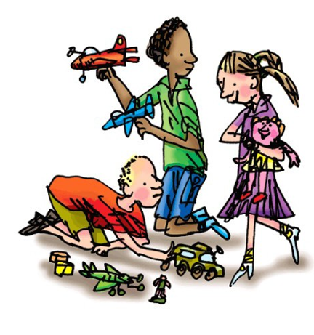
ay
May I play?

Slide 2


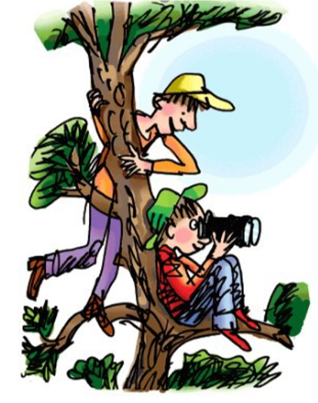
ee
What can you see?

Slide 3
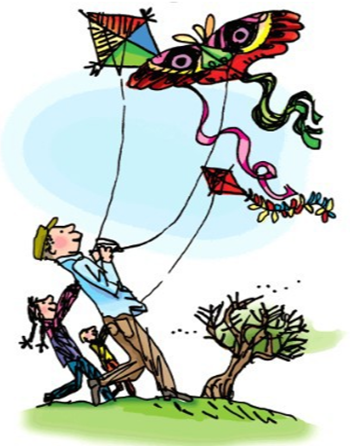
igh
Fly high

Slide 4


ow
Blow the snow.

Slide 5


oo
Poo at the zoo.

Slide 6

oo
Look at a book.

Slide 7
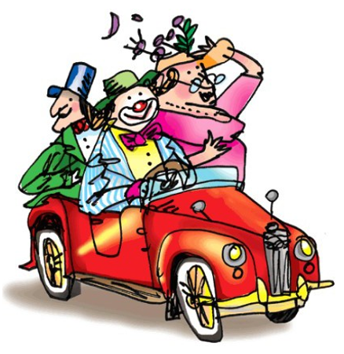
ar
Start the car.

Slide 8
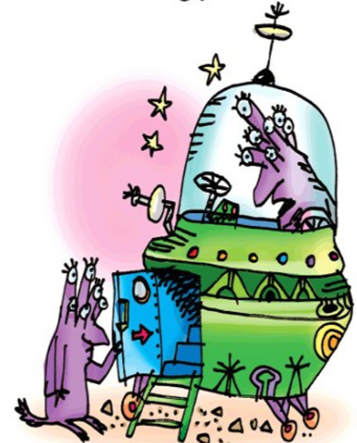
or
Shut the door.

Slide 9
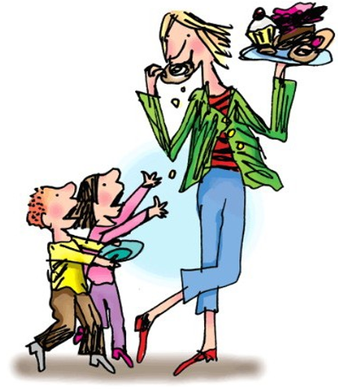
air
That’s not fair!

Slide 10
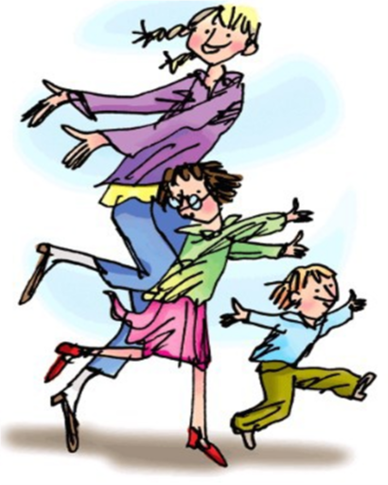
ir
Whirl and twirl.

Slide 11
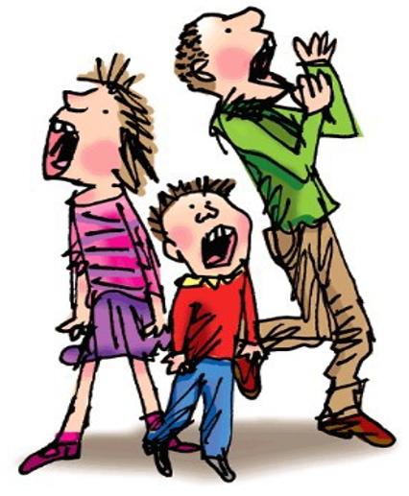
ou
Shout it out.

Slide 12
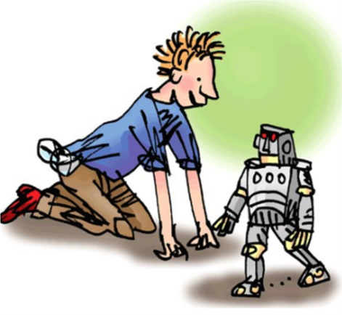
oy
Toy for a boy.

